Slide 1


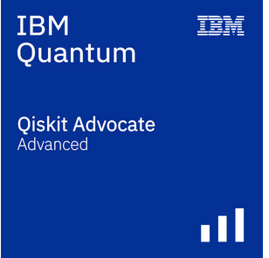

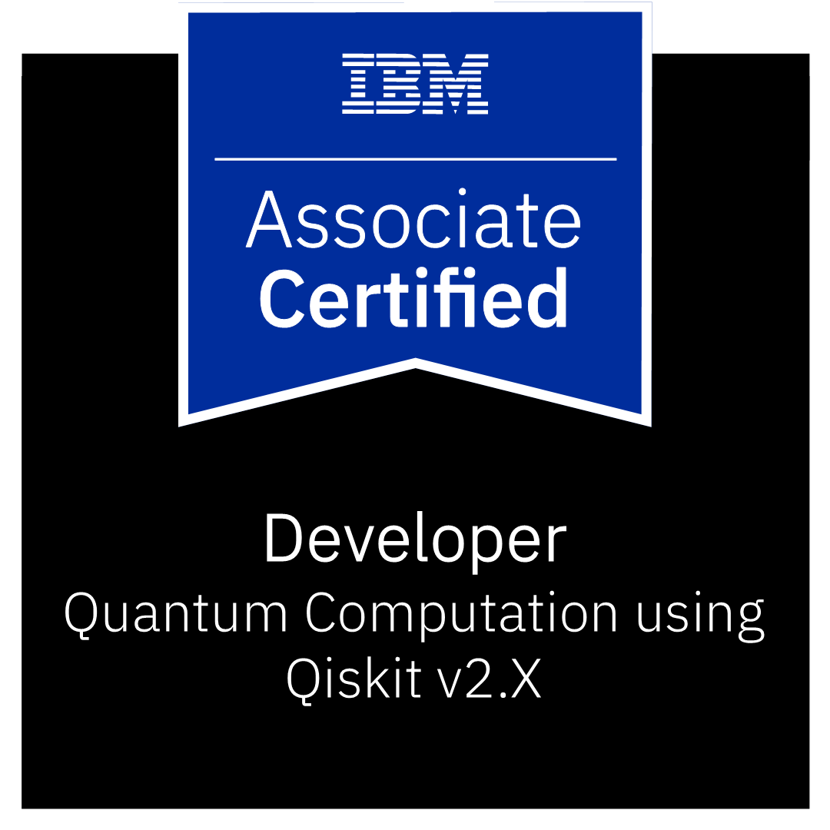

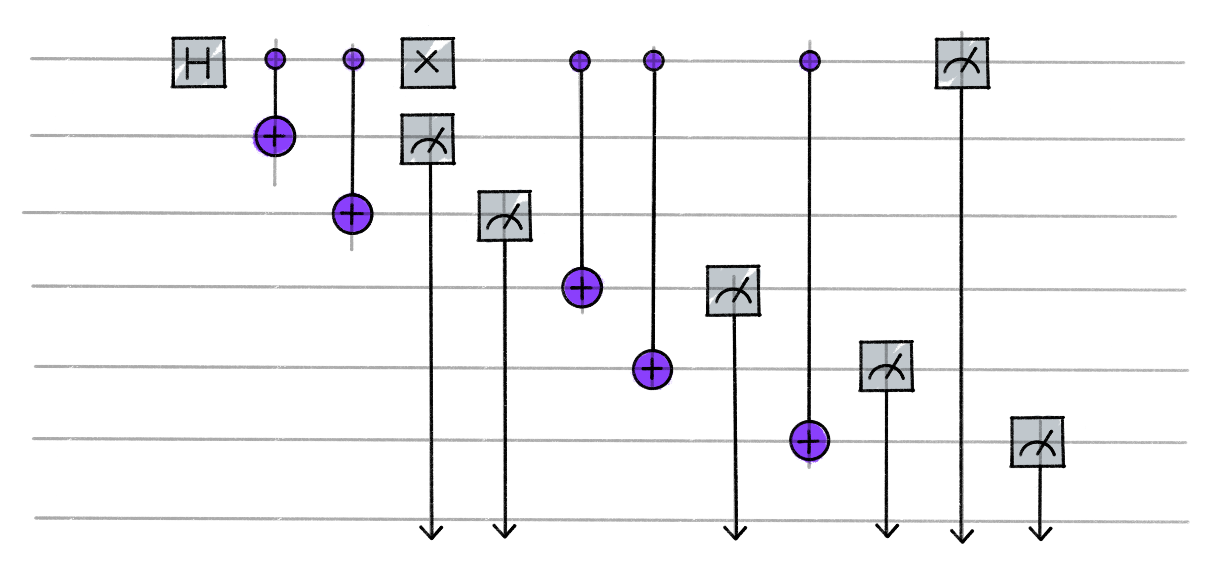

How to become a Qiskit Advocate
Wiktor Mazin & Zina Efchary & Sebastian Grodzietzki & Thorsten Mühge

Slide 2
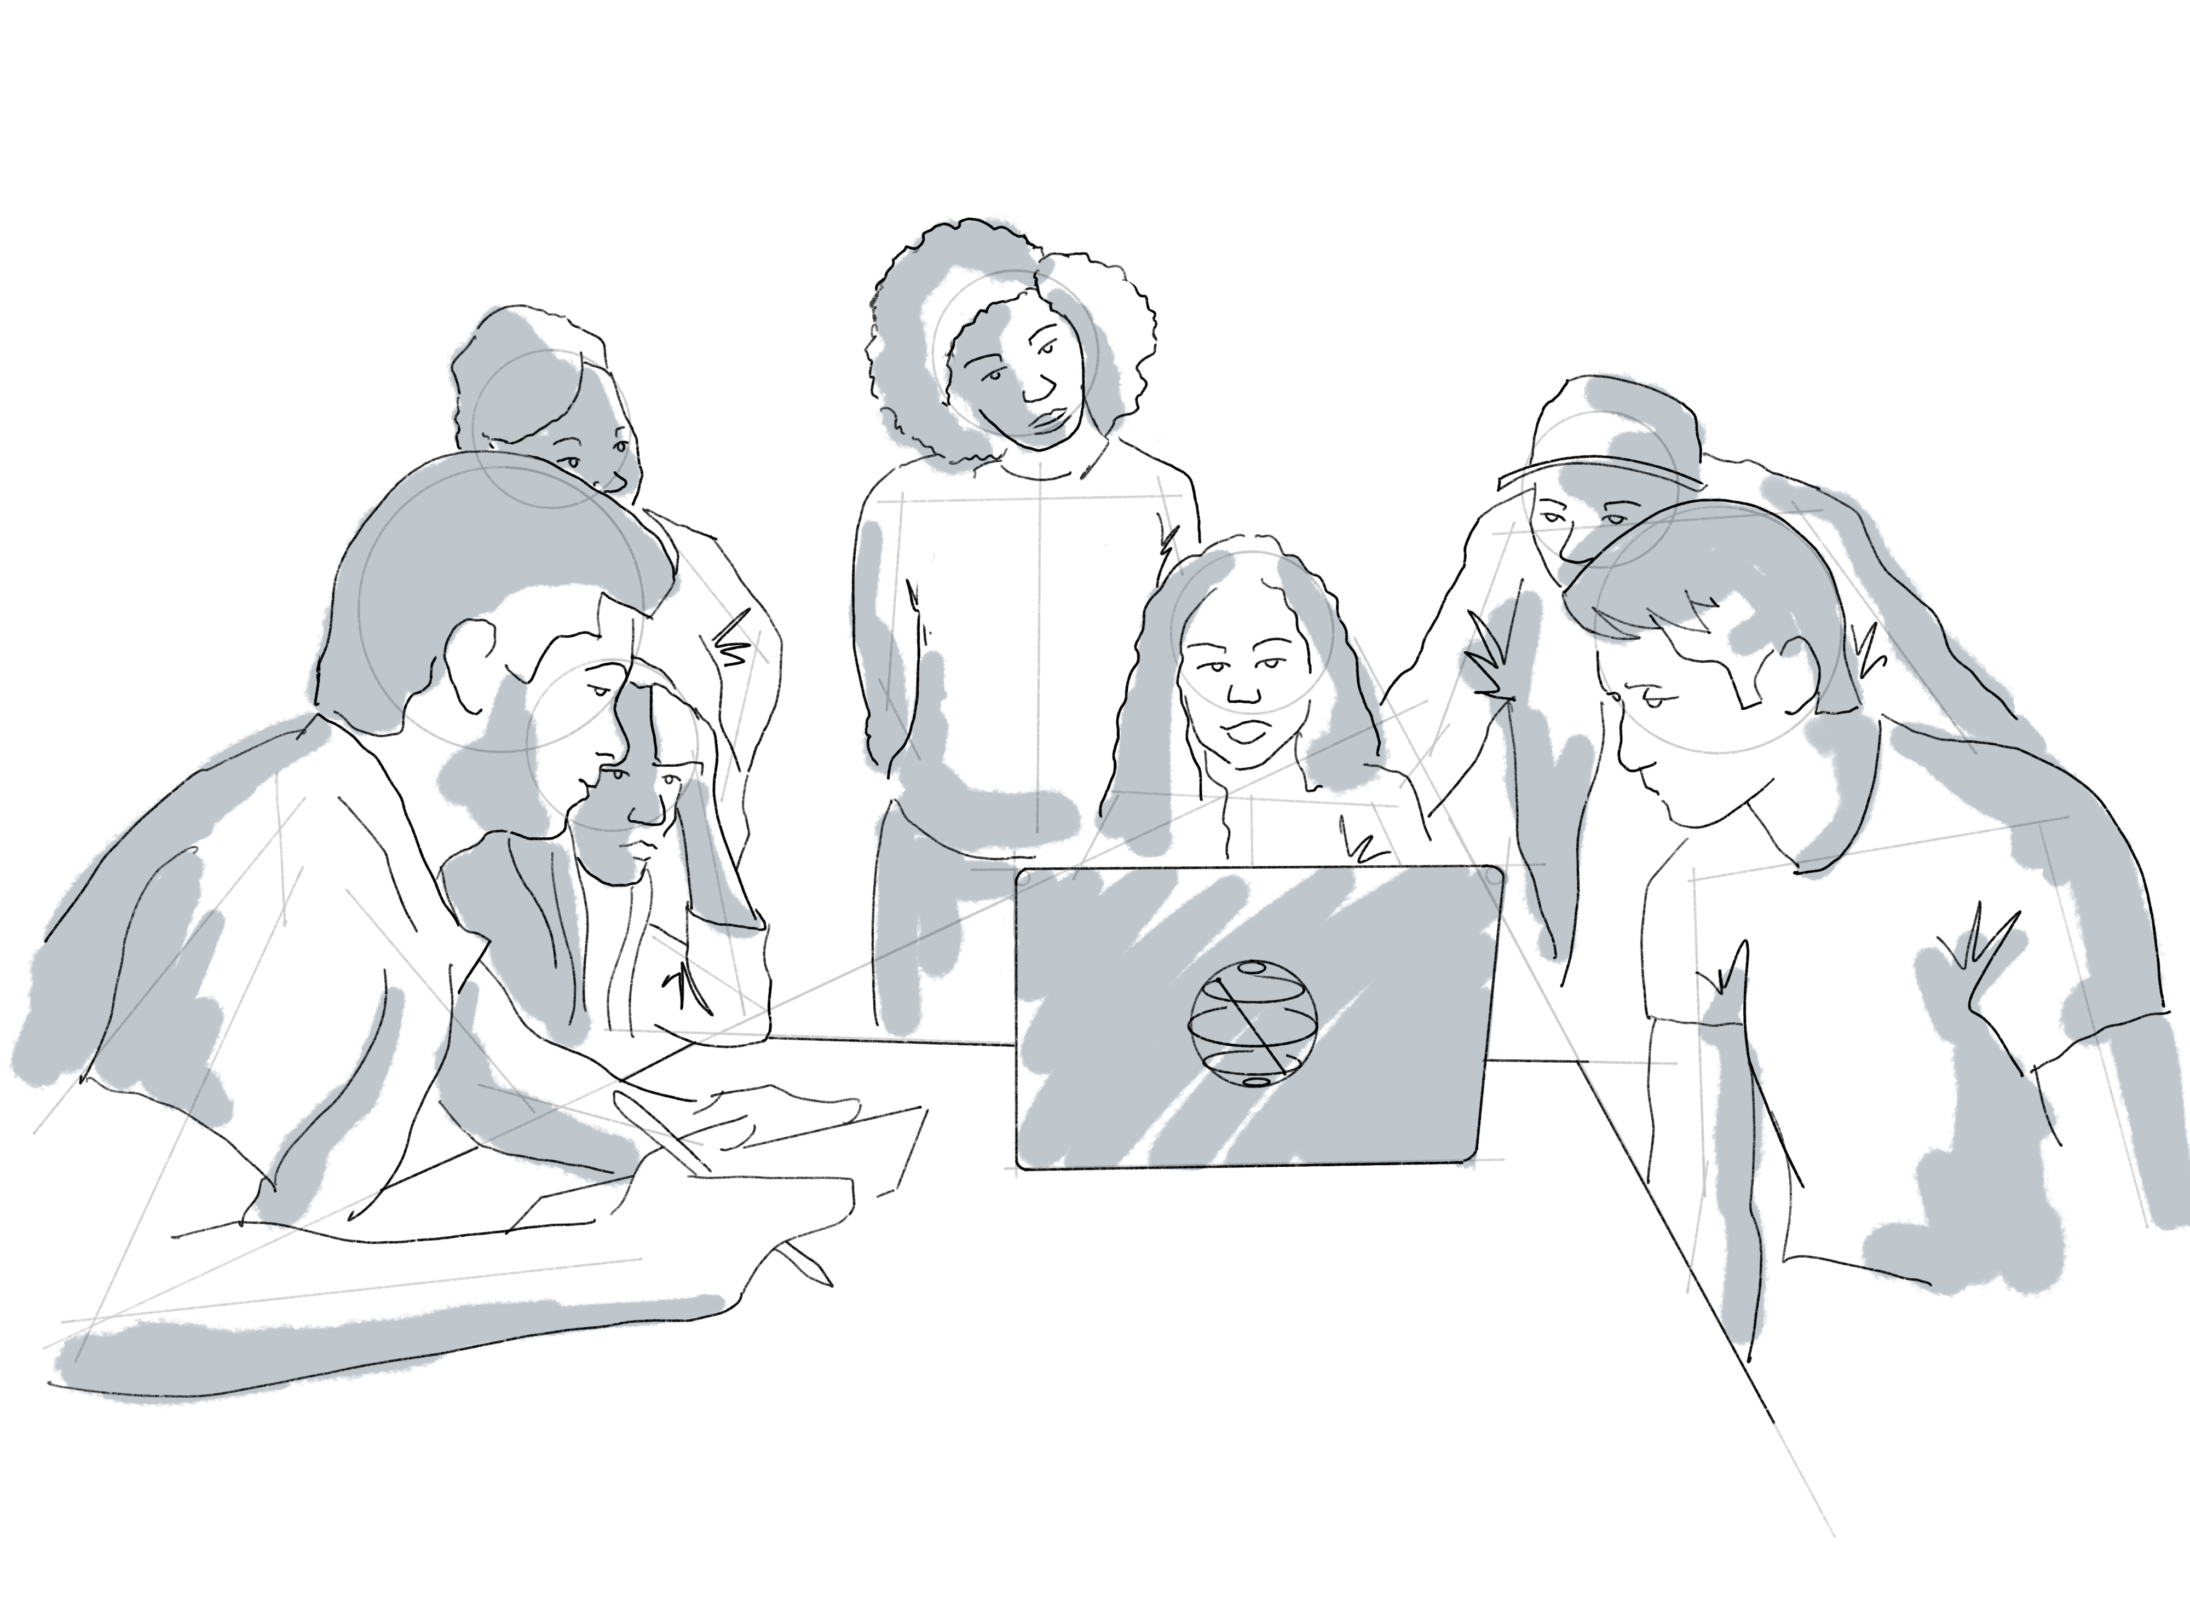
Agenda
What is Qiskit and Qiskit Advocates?
Why should I become a Qiskit Advocate?
What are we planning to do?
Next steps

Slide 3
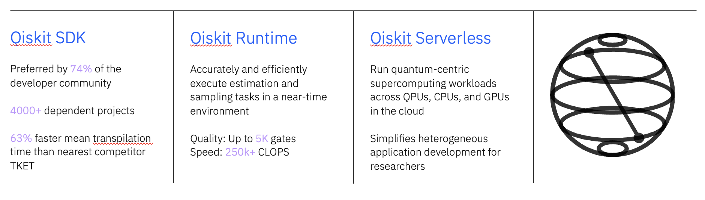
What is Qiskit?
Qiskit is the world’s most popular software stack for quantum computing. Build circuits, leverage Qiskit functions, transpile with AI tools, and execute workloads in an optimized runtime environment.

Slide 4
Qiskit Advocate
https://www.ibm.com/quantum/blog/qiskit-advocate-program
https://www.ibm.com/quantum/community#advocates
Qiskit advocates are a global group of individuals who are passionate about accelerating the advancement of quantum computing and growing the Qiskit ecosystem in collaboration with IBM.
The Qiskit advocate program provides mentorship, education, networking, unique opportunities, and a clear path for progression and recognition.
It guides members on their quantum computing journey with tailored support and resources every step of the way.

Slide 5
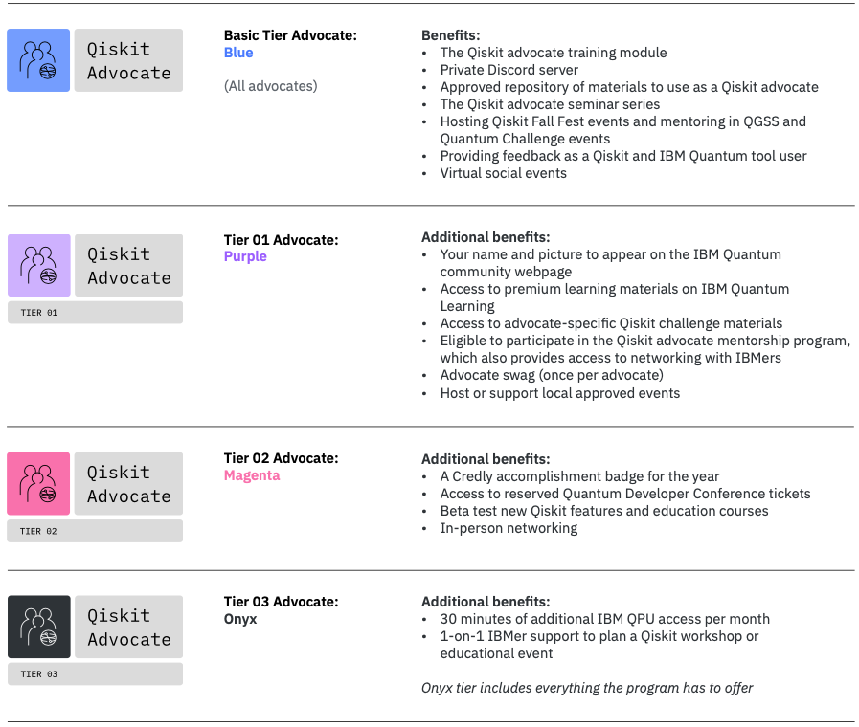
The Advocate Journey
In the new Qiskit advocate program, all advocates begin with core onboarding and training at the base level: tier 0.
This level gives you access to upskilling enablement through exclusive resources like the Qiskit advocate seminar series and the Qiskit advocate library.
As advocates hone their skills and contribute to the community by delivering talks, contributing to Qiskit, and participating in other qualifying activities, they earn points.
Advocates level up to the next tier by crossing a specified points threshold and attaining certification in Qiskit v2.x.

Slide 6
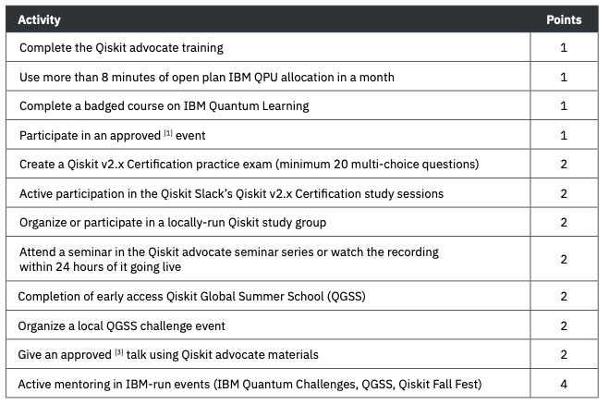
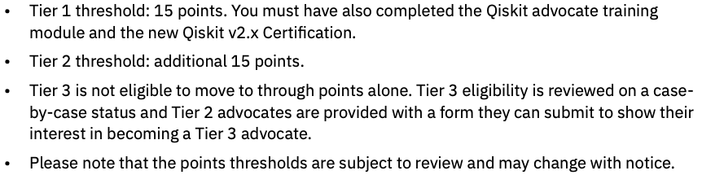
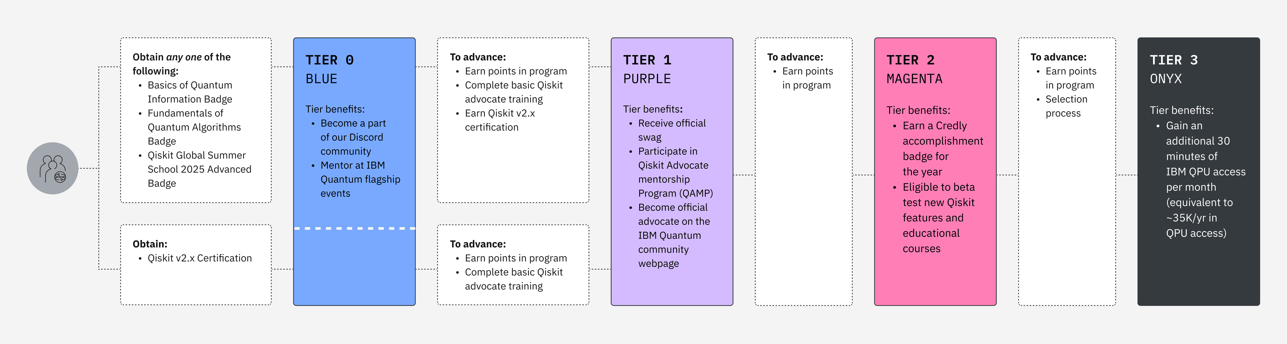
Tier Progression

Slide 7
The Qiskit SDK v2.x developer certification
An IBM certified quantum computational scientist is an individual who possesses a fundamental knowledge of quantum computing concepts and is able to demonstrate this using the Qiskit SDK as well as Qiskit Runtime.
They have experience using the Qiskit SDK from the Python programming language to create and execute quantum computing programs on IBM Quantum computers.

Slide 8
Workgroup: How to become a Qiskit Advocate
Regular calls to prepare for Developer Certificate
Regular calls to prepare for Developer Certificate
10/2025
05/2026
Kick off meeting
Regular calls to prepare for Developer Certificate
Pass and earn the developer Certification
IBM Quantum / © 2025 IBM Corporation

